Slide 1

Optimization Algorithms
Notes:
Hello and welcome to the third presentation in the Practicum AI Deep Learning Foundations workshop series. I’m [[YOUR NAME HERE]], and I will act as your guide and mentor for this learning experience. I currently work as an AI Trainer / Consultant in the Research Computing Department at the University of Florida.
Let’s get started…

Slide 2
Module 3 Objectives
Describe the purpose and process of gradient descent.
Discuss the error loss function.
Describe optimizers.
Adjust a model's hyperparameters to guide its performance.
Notes:
Welcome to the next phase of our Neural Network series: Optimization Algorithms. This module will detail the core mechanism that powers learning in neural networks. This module will focus on gradient descent and how it optimizes neural networks to make more precise predictions. You'll learn how error functions and optimizers work together to measure and minimize (respectively). Finally, you'll train a deep learning model for an image classification task, experiencing gradient descent in action.

Slide 3
Understanding Gradient Descent

Slide 4
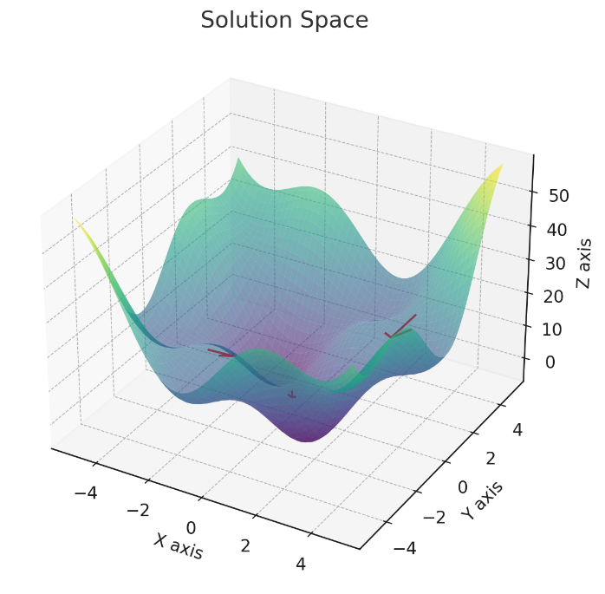
It’s All Downhill From Here
This image was generated using AI tools
Notes:
Gradient Descent is a foundational algorithm in machine learning that is essential for training various models, mainly neural networks. At its core, Gradient Descent operates on the principle of iterative improvement. The algorithm starts with initial estimates for the parameters of a model and then incrementally adjusts them to find the combination that minimizes the error. It uses the gradient, a mathematical concept representing the direction and rate of the fastest increase of a function, to navigate the multi-dimensional landscape of the model's error function.

Slide 5
Cost
0
The learning rate is too small
Start
Cost
This image was generated using AI tools
0
Start
The learning rate is too large
Notes:
Error Function and Its Importance: The error function, or the cost or loss function, quantifies how far a model's predictions are from the actual outcomes. In the context of Gradient Descent, it's the terrain we navigate to find the lowest point, representing the smallest error. While the appropriate error function may be relatively easy in simple models like linear regression, how do you best quantify the error in image classification if the model classifies an image of pizza as a cat? It's wrong, but how bad? Is it better to classify pizza as bread?
The Gradient and How It's Computed: The gradient is the vector of partial derivatives of the error function for each parameter. Computing it involves calculating how much a slight change in each parameter affects the error. This calculation is pivotal, as it points each parameter's vector in the direction where the function decreases most steeply.
The Descent: Step Size and Direction: Gradient Descent moves in the opposite direction of the gradient, towards lower error. The step size, controlled by the learning rate parameter, determines each step's size. If the steps are too large, the algorithm might overshoot the minimum; if too small, the process becomes slow and may get stuck in local minima. The art of Gradient Descent lies in balancing these factors to efficiently reach the lowest point of the error function.

Slide 6
Introduction to Error and Loss Functions

Slide 7
Loss Functions
How do we quantify prediction error?
Notes:
Error and loss functions are fundamental to machine learning, acting as the guiding stars for models during their training phase. These functions quantify the difference between the predicted outputs of a model and the actual target values, offering a measurable way to evaluate and improve model performance.
Different machine learning problems call for other loss functions. Here are some commonly used ones:

Slide 8
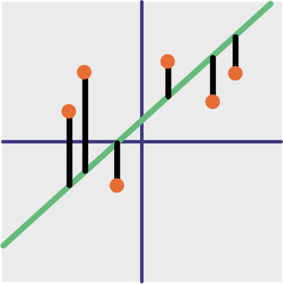
Mean Squared Error (MSE)
Notes:
Mean Squared Error (MSE): A staple in regression tasks, MSE measures the average squared difference between the estimated and actual values. It's handy when larger errors are more significant, as the squaring operation emphasizes larger differences (in addition to making all values positive).

Slide 9
Cross Entropy
Notes:
Cross-Entropy: Widely used in classification tasks, cross-entropy measures the difference between two probability distributions - the actual distribution and the model predictions. It's especially effective in scenarios where the prediction of the probability of a class is required.
There are many more loss functions, but the idea is the same—finding a method to quantify the error or the difference between the prediction and the known value. The error is then used to update the model parameters.

Slide 10
Optimizers and Advanced Gradient Descent Techniques

Slide 11
Notes:
Optimization algorithms vary in their approach to navigating the loss landscape. Remember, not only do we not know what the entire landscape looks like (all the algorithms know is from where I stand now, how can I move to a lower point), but it is highly dimensional. Navigating the hyperdimensional universe in the dark can be a challenge!

Slide 12
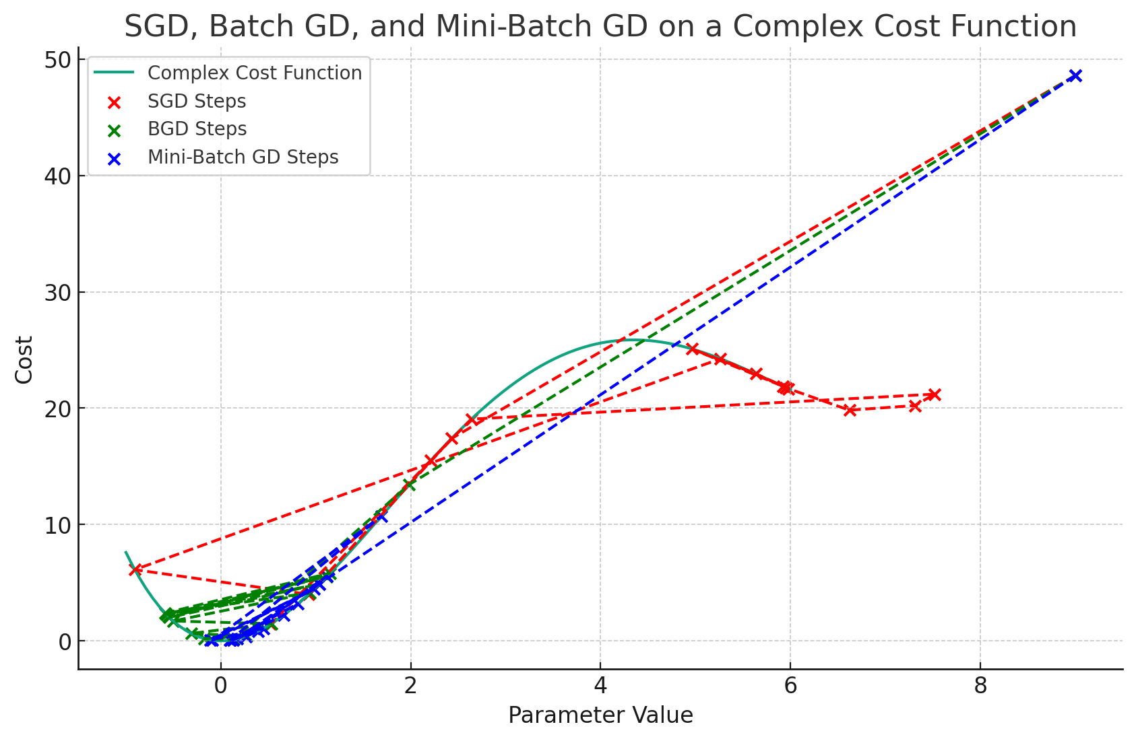
This image was generated using AI tools
Notes:
Stochastic Gradient Descent (SGD): This algorithm represents the simplest form of gradient descent. It updates the model's weights using only one sample at each iteration. While this can make SGD faster and more memory-efficient, it can also make the optimization path noisy and inconsistent.
Batch Gradient Descent: This algorithm simultaneously updates the model parameters using the entire dataset. Unlike SGD, which updates parameters using only one data point at a time, batch gradient descent computes the average gradient from all data points, leading to more stable and consistent parameter updates. However, this can be computationally intensive for large datasets and less efficient than SGD.
Mini-batch Gradient Descent: Striking a balance between batch gradient descent and SGD, this approach uses a subset of the data at each step. This middle ground makes it more stable than SGD and often more efficient than using the entire dataset.
In this graph:
The red dots and dashed line represent the steps and path of SGD. This method shows a more erratic trajectory due to its nature of updating parameters after each data point.
The green dots and dashed line illustrate the BGD steps and path. BGD updates parameters after computing the gradient over the entire dataset, resulting in a smoother and more direct path.
The blue dots and dashed line indicate the MBGD steps and path. MBGD, which updates parameters after computing the gradient over a mini-batch of the dataset, shows a balance between the two, with a trajectory that is less erratic than SGD but more responsive than BGD.

Slide 13
Cost
Cost
Plateau
Local minimum
Global minimum
Local minimum
Global minimum
Notes:
And here are some momentum-based Optimizers:
Adam (Adaptive Moment Estimation): Adam combines the ideas of momentum (considering past gradients) and adaptive learning rates (adjusting the learning rate for each parameter) to make more effective updates.
RMSprop (Root Mean Square Propagation): This optimizer dynamically adjusts each parameter's learning rate, making it effective for problems with noisy or sparse gradients.

Slide 14
Choosing the Right Optimizer: A Quick Guide

Slide 15

This Image Was Generated Using AI Tools
Notes:
Selecting the right optimizer for a specific problem can significantly impact model performance. Here are some guidelines:
Consider optimizers like Adam or RMSprop for sparse data, as they handle noise well.
Traditional SGD can be effective and easier to control for simpler models or smaller datasets.
Experiment with different learning rates and observe the training process. Sometimes, a combination of optimizers used in different training phases can yield the best results.
Stay informed about the latest developments in optimization algorithms, as this is an actively evolving area in machine learning research.

Slide 16
Hyperparameter Optimization
04_bees_vs_wasps.ipynb
This notebook will walk you through building and training your own image classification model, then allow you to compare different hyperparameter optimization configurations!

Slide 17
Questions?
(QR CODE FOR SURVEY!)

